Slide 1
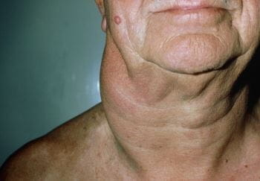
Lecture -2 …...lymphomas
Dr. maher jabbar salih
Assist. PROF. OF ONCOLOGY

Slide 2
AIMS OF THE LECTURE :
DIFINITION OF LYMPHOMAS
TYPES
PATHOLOGY
TREATMENT .

Slide 3
Cells of origin :
From the lymphocyte mainly the B lymphocyte , found in the LN any tissue containing lymphocyte , also in the reticuloendothelial system .

Slide 4
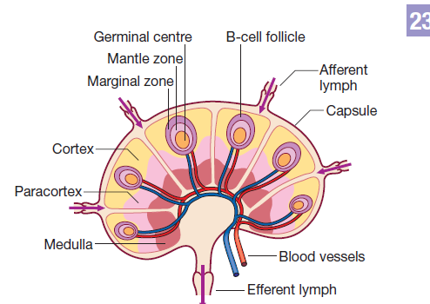

Slide 5
2 types according to grade .
High-grade tumours divide rapidly, are typically present for a matter of weeks before diagnosis, and may be lifethreatening with frequent risk of extranodal involvement.
DLBCL
BURKITTS L.
PTCL
• Low-grade tumours divide slowly, may be present for many months before diagnosis, and typically behave in an indolent fashion

Slide 6
Hodgkin lymphoma
The histological hallmark of Hodgkin lymphoma (HL) is the
presence of Reed–Sternberg cells: large, malignant lymphoid cells of B-cell origin .
They are often present only in small numbers but are surrounded by large numbers of reactive non-malignant T cells, plasma cells and eosinophils.

Slide 7
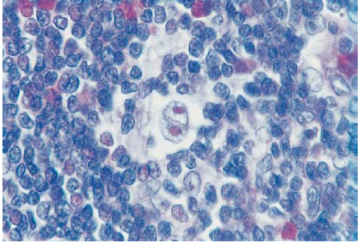
The classical RS cells.

Slide 8
Classical HL is divided into four histological subtypes from the appearance of the Reed–Sternberg cells and surrounding reactive cells.

Slide 9
Subtypes of classical HL
The nodular sclerosing type is more common in young patients and in women….mediastinal mass
Mixed cellularity is more common in the elderly.
Lymphocyte-rich HL usually presents in men.
Lymphocyte-depleted HL is rare and probably represents large-cell or anaplastic non-Hodgkin lymphoma.
Another …….

Slide 10
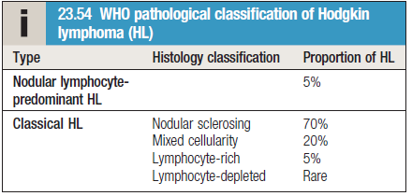

Slide 11
Epidemiology :Epidemiology
Incidence
• Approximately 4 new cases/100 000 population/year
Sex ratio
• Slight male excess (1.5 : 1)
Age
• Median age 31 years; first peak at 20–35 years and second at 50–70 years

Slide 12
Etiology
• Unknown
• More common in patients from well-educated backgrounds and small families
• Three times more likely with a past history of infectious mononucleosis but no definitive causal link to Epstein–Barr virus infection proven

Slide 13
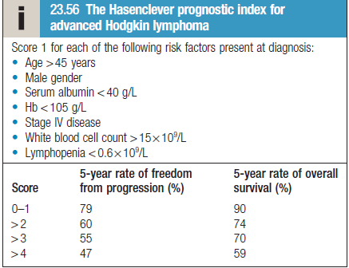

Slide 14
Clinical features
LAP….painless rubbery
Contiguous involvement..
SOB …………nodular sclerosing type ?
Constitutional symptoms …..
Organomegally ….
Bone marrow infiltration .
Others……..

Slide 15
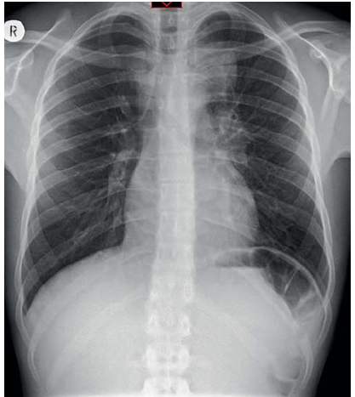
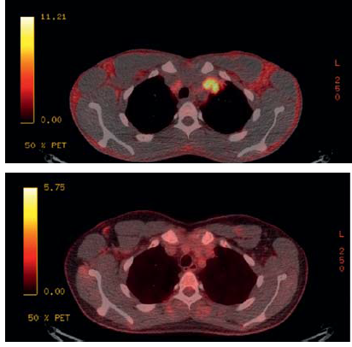
Left upper mass with Rt. Tracheal shift
PET scan +ve

Slide 16
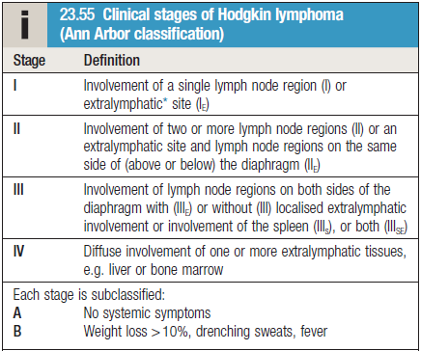
Staging system :

Slide 17
Investigations
CBC
ESR
Liver function
Renal function
LDH measurements
Chest X-ray
CT scan
Positron emission tomography (PET

Slide 18
Specific investigations
FNA
Core Biopsy
Incisional biopsy .
Excisional biopsy.
Immune histochemistry .

Slide 19
Management (first line )
Stage 1A,IIA.(favourable) : 2cycles +RT or 3 CYCLES without radiotherapy….ABVD protocol
A..adriamycin
B…bleomycin
V…..vinblastin
D….dacarbazin
Stage 1,2 (Unfavourable)…..4 cycles chemoth.
same ABVD or BEACOPP
Others higher stages : 6 -8 cyles chemoth

Slide 20
ABVD chemotherapy can cause cardiac and pulmonary toxicity ,due to doxorubicin and bleomycin, respectively.
The incidence of infertility and secondary myelodysplasia/AML is low with this regimen.

Slide 21
Non-Hodgkin lymphoma
represents a monoclonal proliferation of lymphoid cells of B-cell (90%) or T-cell (10%) origin.
The current WHO classification stratifies according to cell lineage (T or B cells) and incorporates clinical features, histology, chromosomal abnormalities and concepts related to the biology of the lymphoma.

Slide 22
Clinically, the most important factor is grade, which is a reflection of proliferation rate.
High-grade NHL has high proliferation rates, rapidly produces symptoms, is fatal if untreated, but is potentially curable.
Low-grade NHL has low proliferation rates, may be asymptomatic for many months or even years befor presentation, runs an indolent course, but is not curable by conventional therapy

Slide 23
Epidemiologically : disease of elderly 60-70 years.
Etiology :
It has many etiological factors (compare with HL )…
Notes:
\;vtr

Slide 24
Specific causes:
Specific lymphoma types are associated with viruses:
e.g.
1- Epstein–Barr virus (EBV) with post-transplant NHL,
2-human herpesvirus 8 (HHV8) with a primary effusion lymphoma .
3-and human T-cell lymphotropic virus (HTLV-1) with adult T-cell leukaemia lymphoma
4-Gastric lymphoma can be associated with Helicobacter pylori
infection
5- Some lymphomas are associated with specific chromosomal translocations: t(14;18) in follicular lymphoma results in the dysregulated expression of the BCL-2 gene product, which inhibits apoptotic cell death.
t(8;14) found in Burkitt lymphoma and
t(11;14) in mantle cell lymphoma alter function of c-myc and cyclin D1.

Slide 25
High grade NHL:
1-Burkkits lymphoma .
2-T-cell lymphoblastic lymphoma .
3-DLBCL
4-AIDS-related lymphoma .
Majority of NHL ( tow thirds of them are DLBCL and follicular lymphoma ).
DLBCL=diffused large B cell lymphoma .
Long list of subtypes of NHL………..

Slide 27
Clinical features
Same as in HL , but it has :
wide dissemination at time of DX .
Extra nodal sites.
Pressure symptoms …SVO
Bone marrow involvment .
GIT , lung , brain thyroid , testis involvment .
. Bone marrow involvement is more common in low-grade (50–60%) than high-grade (10%)

Slide 28
Staging system
The same as in HL .
And usually NHL present with stage 3-4 .

Slide 29
Investigations
Same as in HL but may needs also :
Bone marrow examination .?
Immunophenotyping of surface antigens to distinguish
T-cell from B-cell tumours.
Cytogenetic analysis .
Measurement of uric acid levels…predict tumor lysis syndrom.
HIV testing…
Hepatitis B and C testing. This should be done prior to
therapy with rituximab….risk of hepatitis reactivation .

Slide 30
Treatment :
Low grade :
Majority of pt. have advanced disease with relapsing remitting course , and needs observation only .
Indications of treatment :
Symptomatic organomegally ,
cytopenia ,
constitusional symptoms .

Slide 31
Options of treament :
Radiotherapy ..localised RT.
Chemotherapy …single agent orally chlorambucil may be enough.,or combination chemotherapy .(RCHOP, R-bendamustin).
BMT.

Slide 32
High-grade NHL (DLBCL)
Urgent treatment with chemoth. Is important to prevent complications and death because it is very aggressive tumour.
Combination chemoth like R-CHOP +_ radiotherapy to the involved site .
BMT as a consolidation therapy may be considered .

Slide 33
Prognosis :
Low grade type : indolent course with multiorgan involvment at time of DX . Median survival is 1 year .
High grade type , 75% of pt will respond to therapy with 50% (5-year survival ).
Relapse is associated with very poor outcome .

Slide 34
Late complications:
Cardiotoxicity …..ADM
Pulmonary toxicity ….bleomycicn.
PNP …Vinblastin
Second malignancy.
Hepatitis reactivation .

Slide 35
Thanks for listening.

